Slide 1
Middle School 101 For Parents
Rule #1
DON’T PANIC! ☺

Slide 2
MORNING ARRIVAL
Doors open at 8:20 am.
There is no supervision for students who are dropped off prior to 8:20 am.
Dismissal is at 4:10 pm. If students do not ride a bus, they must leave campus grounds promptly when dismissed. There is no supervision for students after 4:20 pm.

Slide 4
CAFETERIA
Students may bring cash or parents may deposit money to lunch account via online system.
Go to https://www.schoolcafe.com/fbisd,
Breakfast served from 8:20 – 8:45
Breakfast - Students $2.00
Reduced Price - $ .30
Lunch times – see Bell Schedule
Lunch - Secondary $3.00
Reduced Price - $ .40
Free/Reduced lunch applications MUST be completed ONLINE and renewed each year at https://www.schoolcafe.com/fbisd The online application opens on August 1st.

Slide 5
Emergency Information
List any names and numbers of people that
you trust to pick up your child if he/she is ill or if
an emergency occurs.
We will not release your child to someone who
is not listed, even if we receive your verbal permission over the phone. For your child’s safety, we must have written authorization.

Slide 6
ATTENDANCE
Attendance is taken every class period in middle school.
It is not necessary to call the school before the absence.
Students should not be calling/texting parents to be picked up. The clinic will contact you if it is necessary for your student to go home early.
Parents are not required to check students in; students can check in themselves with a note.
Students will only be released to authorized adults with valid photo ID.
Please allow sufficient time when picking up for appointments.
Students will not be released after 3:40 pm.
More detailed info on GMS website.

Slide 7
Front Office notes
No deliveries for students
Exceptions (glasses, hearing aids)
Leave messages for teachers/staff so they may return your call
Refer to Skyward Family Access for your child’s schedule and teacher email
Listen to messages and check email before calling the school saying you missed a call
Lunches may not be delivered. Student can charge lunch to their account and account must be paid in timely manner

Slide 8
Technology Device Policy
At 8:45 a.m. morning dismissal?
IN THE BACKPACK.
Waiting for your teacher to let you into class?
IN THE BACKPACK
In the classroom before the bell rings?
IN THE BACKPACK
During class WITHOUT teacher permission?
IN THE BACKPACK
Transitioning to classes?
IN THE BACKPACK

Slide 9
DRESS CODE

Slide 10
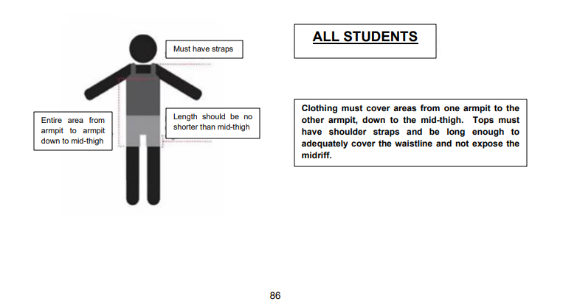

Slide 11
Consequences for Dress Code Violations
Student given opportunity to phone home for a change of clothes.
Campus will loan shirt/shorts on the first offense so that instructional time is maximized.
A referral is entered into Skyward for documentation.
Student MAY NOT wear PE Uniform outside of gym class.

Slide 12
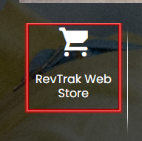
PE Uniforms
Visit GMS website
Click the RevTrack icon:
Select PE Uniforms
Uniforms delivered to students after the 1st week of school.

Slide 13
LOCKERS
Academic Lockers will not be used this year. Students will carry their backpacks
Students will need to purchase a combination lock for use in PE
If students are in BAND, they will need a second combination lock for their BAND locker.
Check Target or Wal-mart for a TWIN pack, 2 locks with the same combination!
YouTube videos to teach kids how to use lock.

Slide 14
TARDIES
Tardies accumulate for all classes throughout the 9-week grading period.
Consequences begin at 4 tardies and escalate if tardies persist.
Review your child’s schedule and help him/her find the best route to/from classes.
WEB Leaders will be helping with this
Encourage your child to plan a bathroom routine

Slide 15
Student IDs (delayed)
Students will be issued a picture ID that contains a scholarchip.
Students are required to wear the ID at all times
The ID will be used to purchase lunch and check out library books
Students may be assigned lunch detention if they forget/lose their ID
Replacement IDs will cost $5

Slide 16
Stay Informed
Family Access through Skyward
Check grades, cafeteria balances, tardies, attendance
Set notifications based on preferences
Contact teachers via e-mail
Weekly Smore Newsletter
Campus Website: www.fortbendisd.com/gms
Schoology
Follow us on Twitter: @GarciaMS_Gators

Slide 17
First Day of SCHOOL…
Students only need a pen/pencil
Send a sack lunch the first week if possible
Make sure your child knows his full address and phone number
If he/she is a bus rider, please have him/her ride the bus to and from school on the first day to help us establish routines & procedures
Be aware that bus routes will be running a little slower than usual on the first few days as drivers/students get used to new routes
6th graders will be directed to report to the gym and be assisted by WEB Leaders in finding their 1st Period teacher’s name and taking a seat in that teacher’s section.
The middle school campus is a NO PARENT zone ☺

Slide 18
Gator Camp
The first day of school will be a revised bell schedule.
Each class period students will learn and practice different rules and procedures to get acclimated to the “Gator Way”

Slide 19
GMS PTO
Please get involved!
Membership
Spirit Gear
Committees

